Slide 1
Virtual smart home automation system simulating MQTT network
ID 2012 (Ubiquitous Computing)
Rafat Khan

Slide 2
01
02
03
IoT and MQTT
Smart Home
Implementation
CONTENTS OF THIS Presentation
The necessity and workflow of MQTT
Concept of smart home automation
Implementation of current scope

Slide 3
IoT and MQTT
01
Definition and Relevence

Slide 4
IoT is a collection of devices communicating each other!
The Internet of things describes physical objects with sensors, processing ability, software, and other technologies that connect and exchange data with other devices and systems over the Internet or other communications networks.
They need
Communication Protocols
Can we use communication protocols used for networking for IoT?

Slide 5
Solution
TCP/IP or Others
Extension
MQTT
Not a good fit to the IoT environment.
Extensions to existing protocols in the TCP/IP protocol suite.
The standard for IoT messaging.

Slide 6

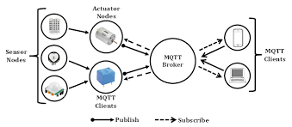
MQTT - The Standard for IoT Messaging

Slide 7
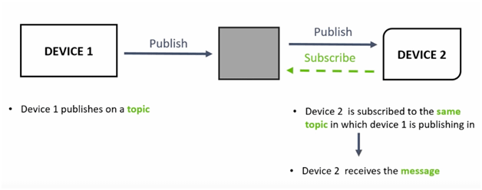
The publish/subscribe pattern

Slide 8
Current Features
Feature 1
Feature 3
Feature 2
Feature 4
The heaters of different rooms activate/deactivate according to the room temparature.
User has override access from the dashboard.
Weather station fetch current weather info using API call.
The rollar blinds open/shut automatically on sunrise/sunset

Slide 9
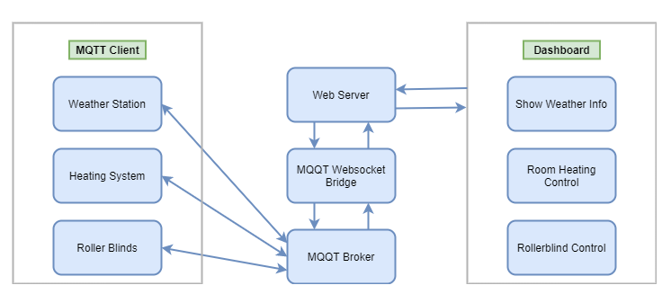
WORKFLOW

Slide 10
THANKS!
Do you have any questions?
rafatk@kth.se
Please keep this slide for attribution.

